Slide 1
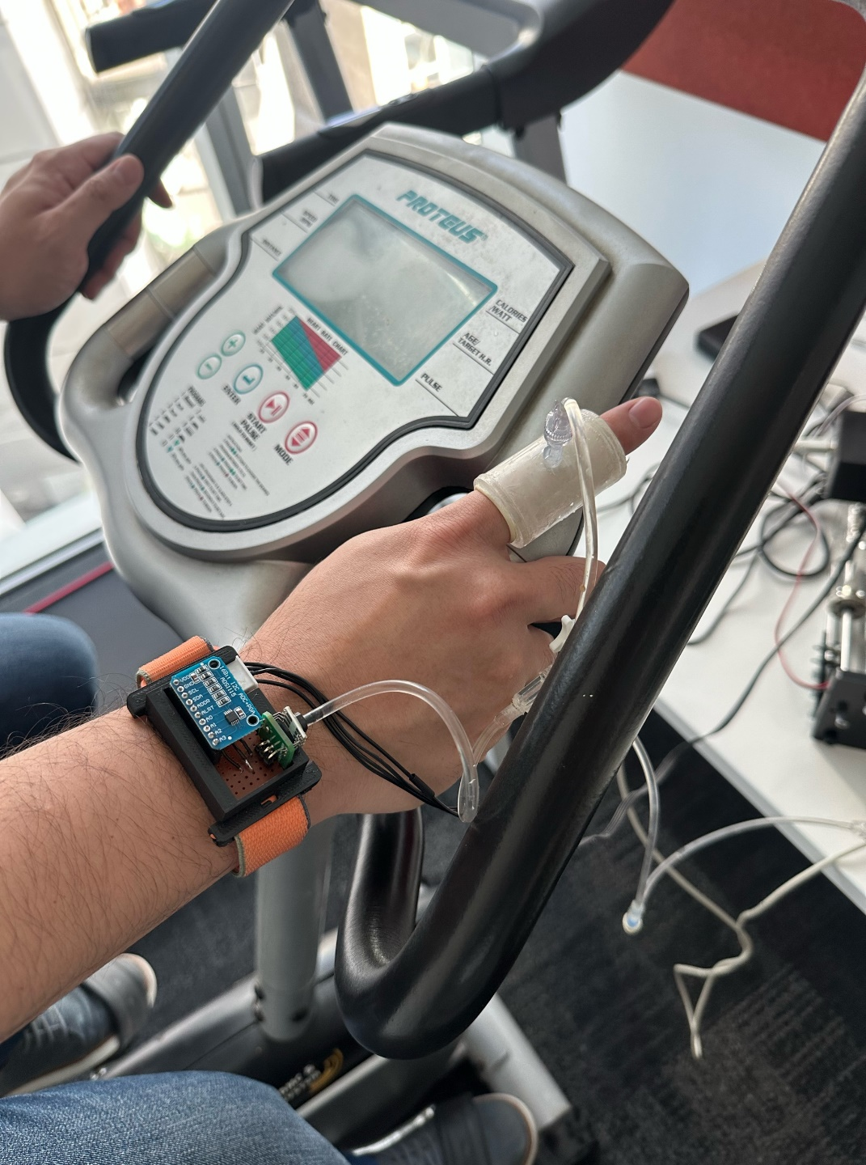

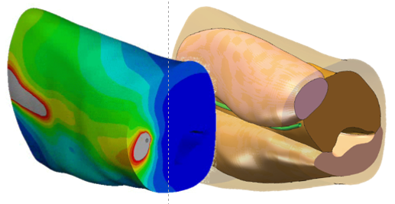
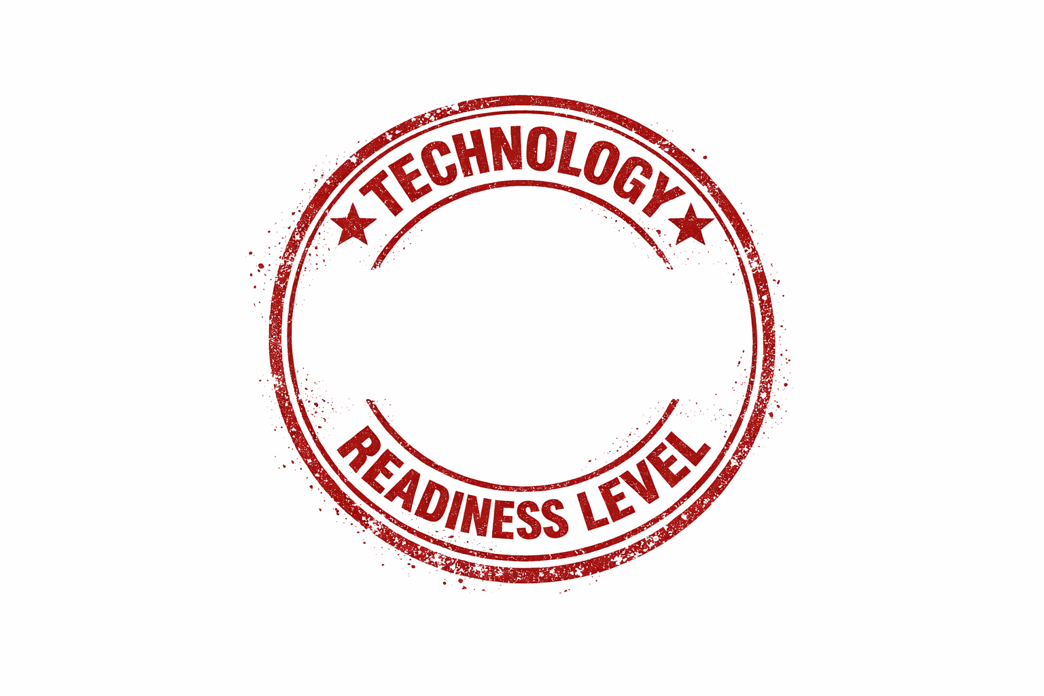
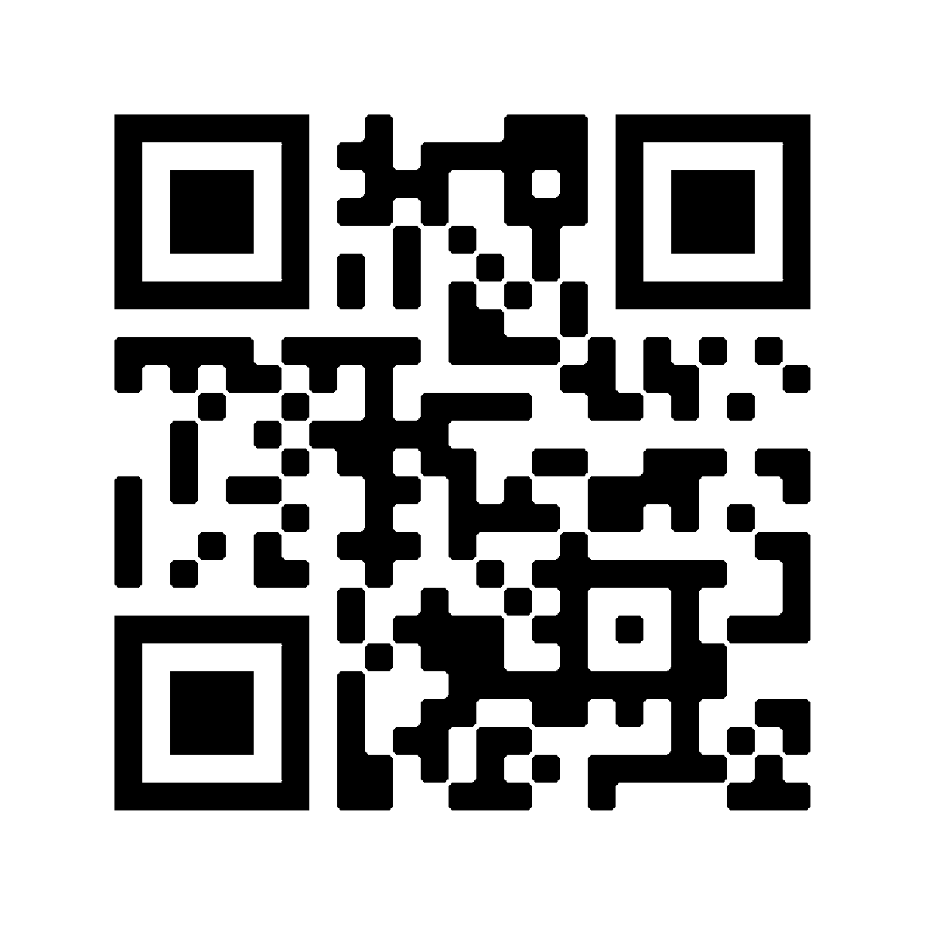
NextBP: A new way to measure blood pressure
Bringing health technology to life
A core problem with existing blood pressure (BP) measurement is that the device must guess important factors such as arm size and shape, amount of muscle vs. fat, and physiological status. Errors are therefore worse for patients that are not “normal”.
NextBP technology measures BP using physics to rapidly (within 15 seconds) build a “virtual twin” of soft tissue mechanics. This opens the way to continuously estimate BP more accurately, especially for unusual, rapidly changing physiology, and irregular heart rhythms.
 Virtual twin of patient mechanics.
⇒ Continuously estimated blood pressure
5
“Blood pressure measurements are most unreliable for the sickest patients” - Paramedic
References:
Sheikh, A. B. et al. Blood Pressure Variability in Clinical Practice: Past, Present and the Future. Journal of the American Heart Association 12, e029297 (2023).
Zheng, Z. et al. Advances in principles and technologies of non-mechanical blood pressure monitoring. npj Cardiovasc Health 3, 7 (2026).
Patent: AU 2026901401 (Filed)
20 26
This research has been supported by the New Zealand Ministry of Business Innovation and Employment and the KiwiNet PreSeed Accelerator Fund.
COLLABORATION OPPORTUNITIES
We are actively seeking collaboration with healthcare providers, research institutions, and industry partners to accelerate clinical validation and real-world deployment. If
you are interested in advancing cardiovascular
monitoring, we welcome the opportunity to connect.
ibtec.aut.ac.nz
Bringing health technology to life

Slide 2
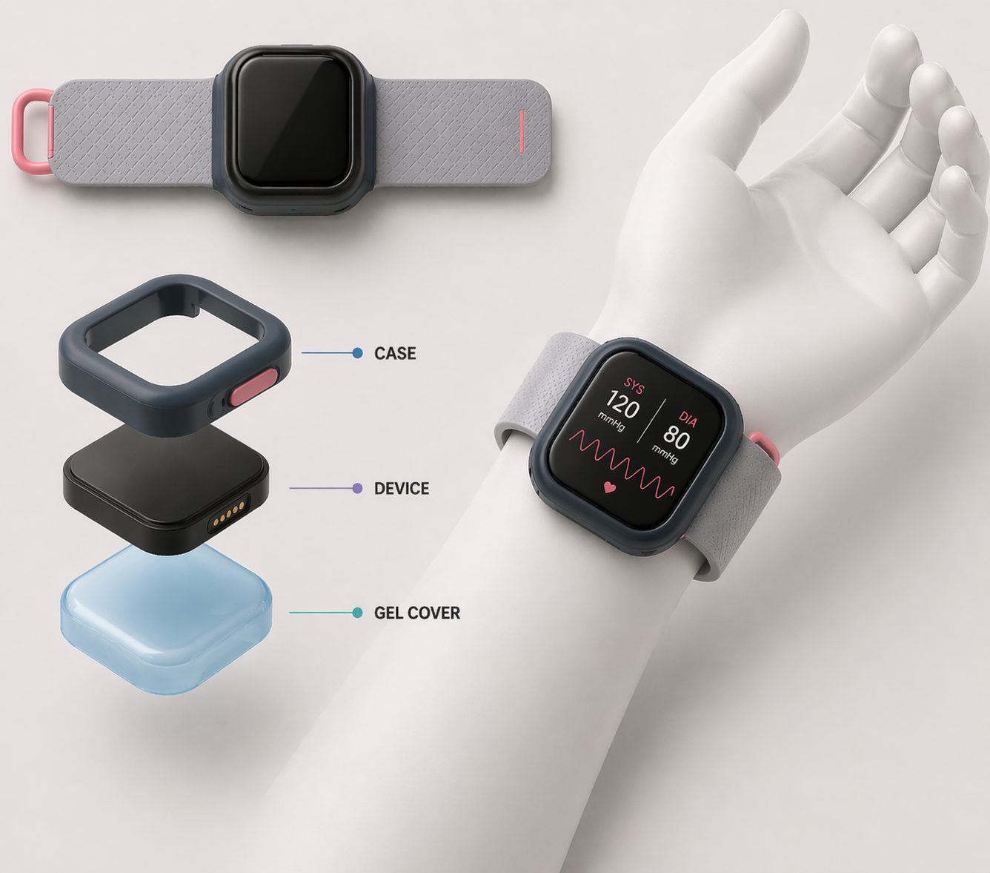
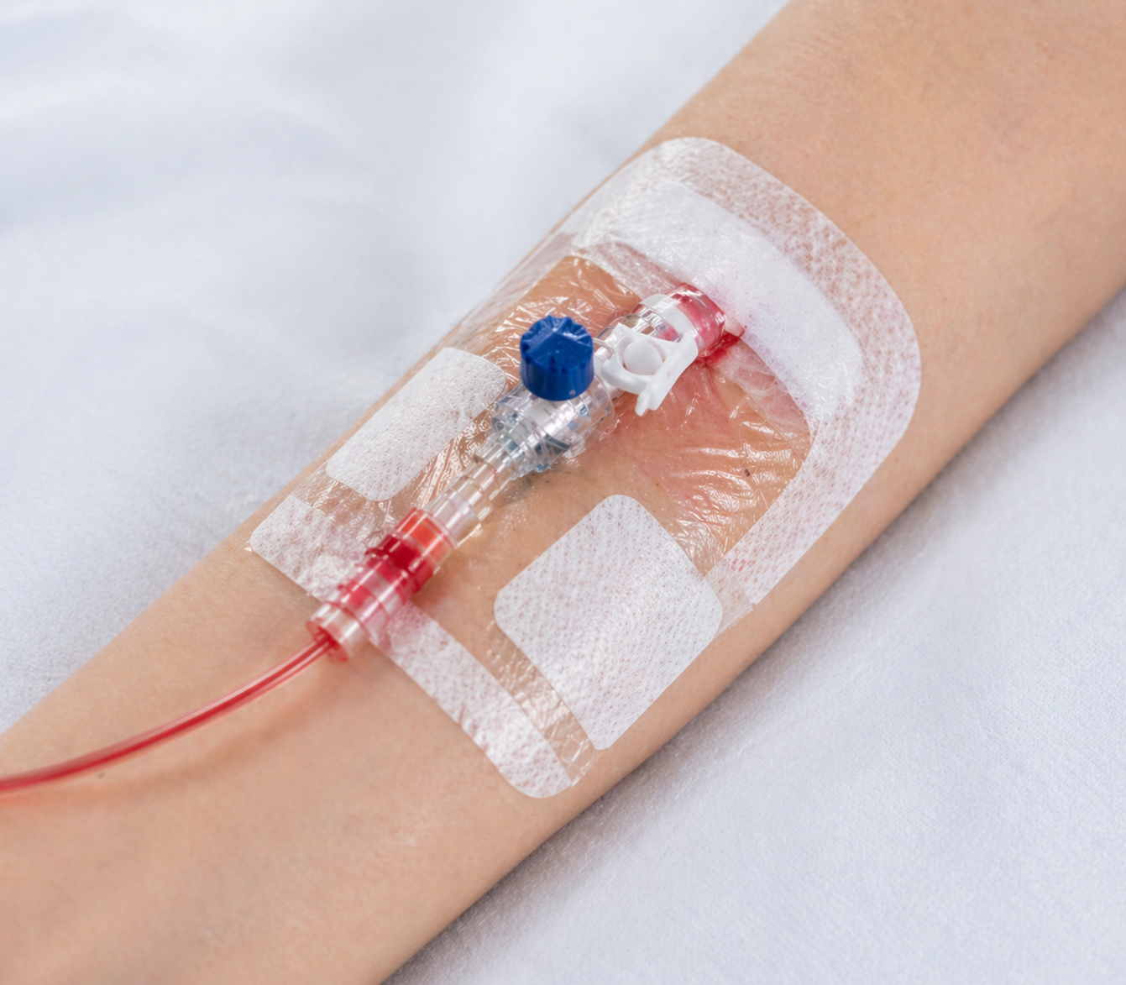

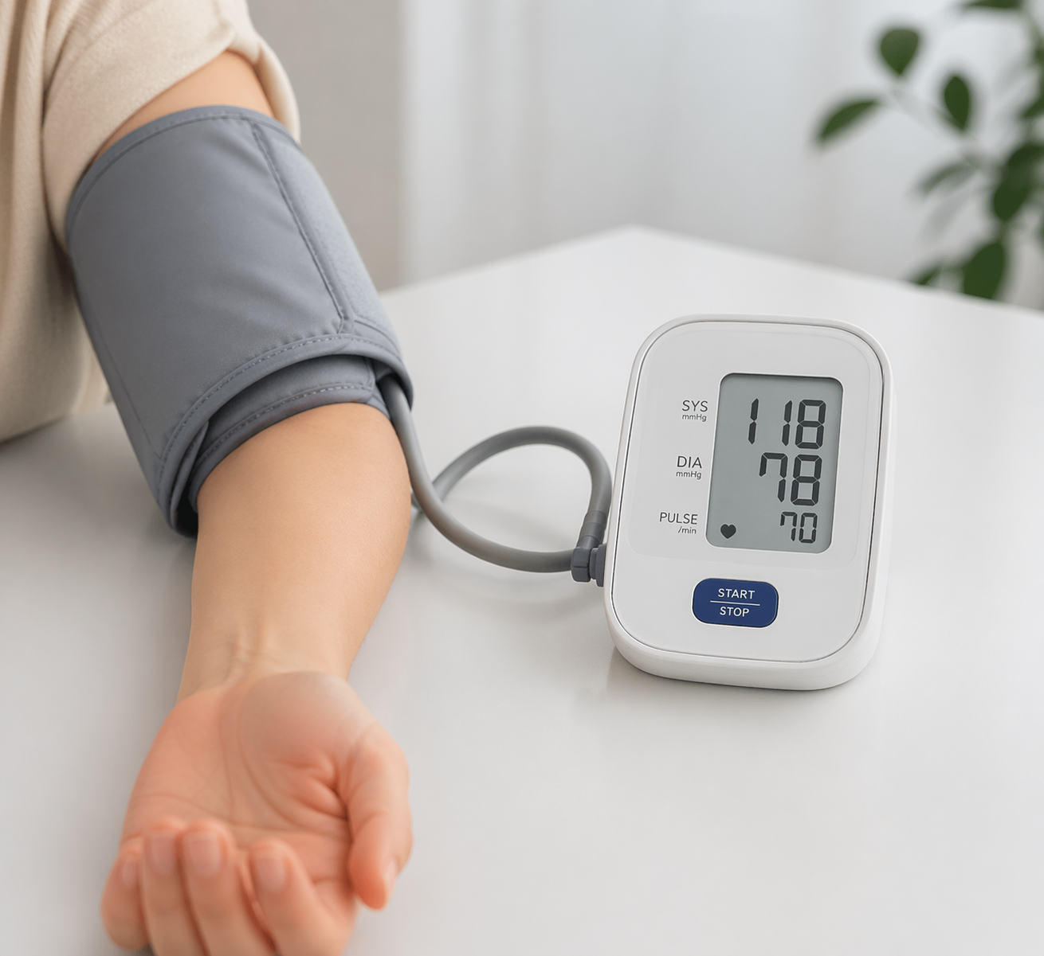
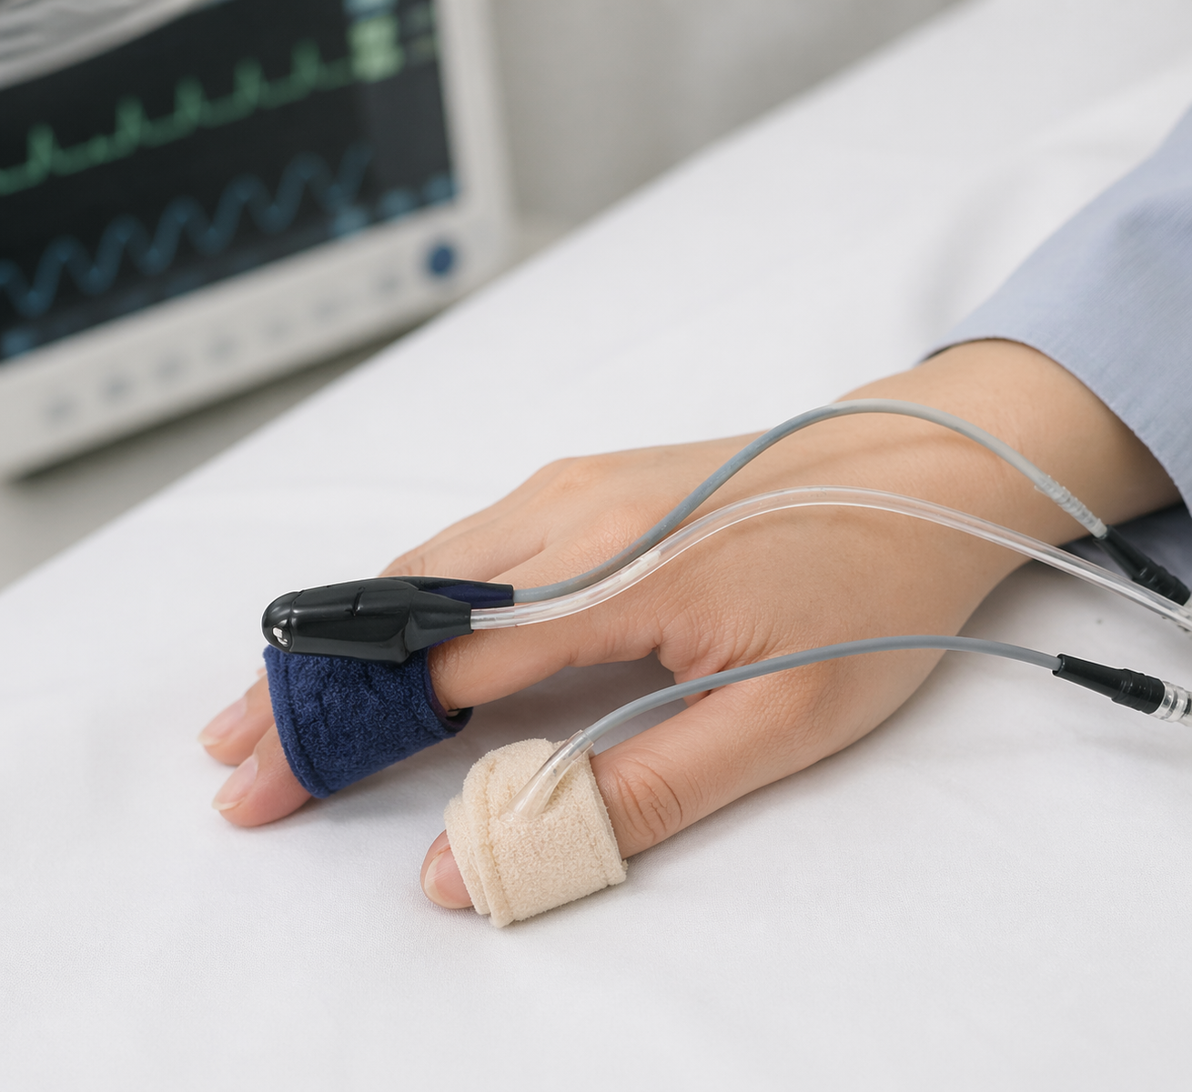
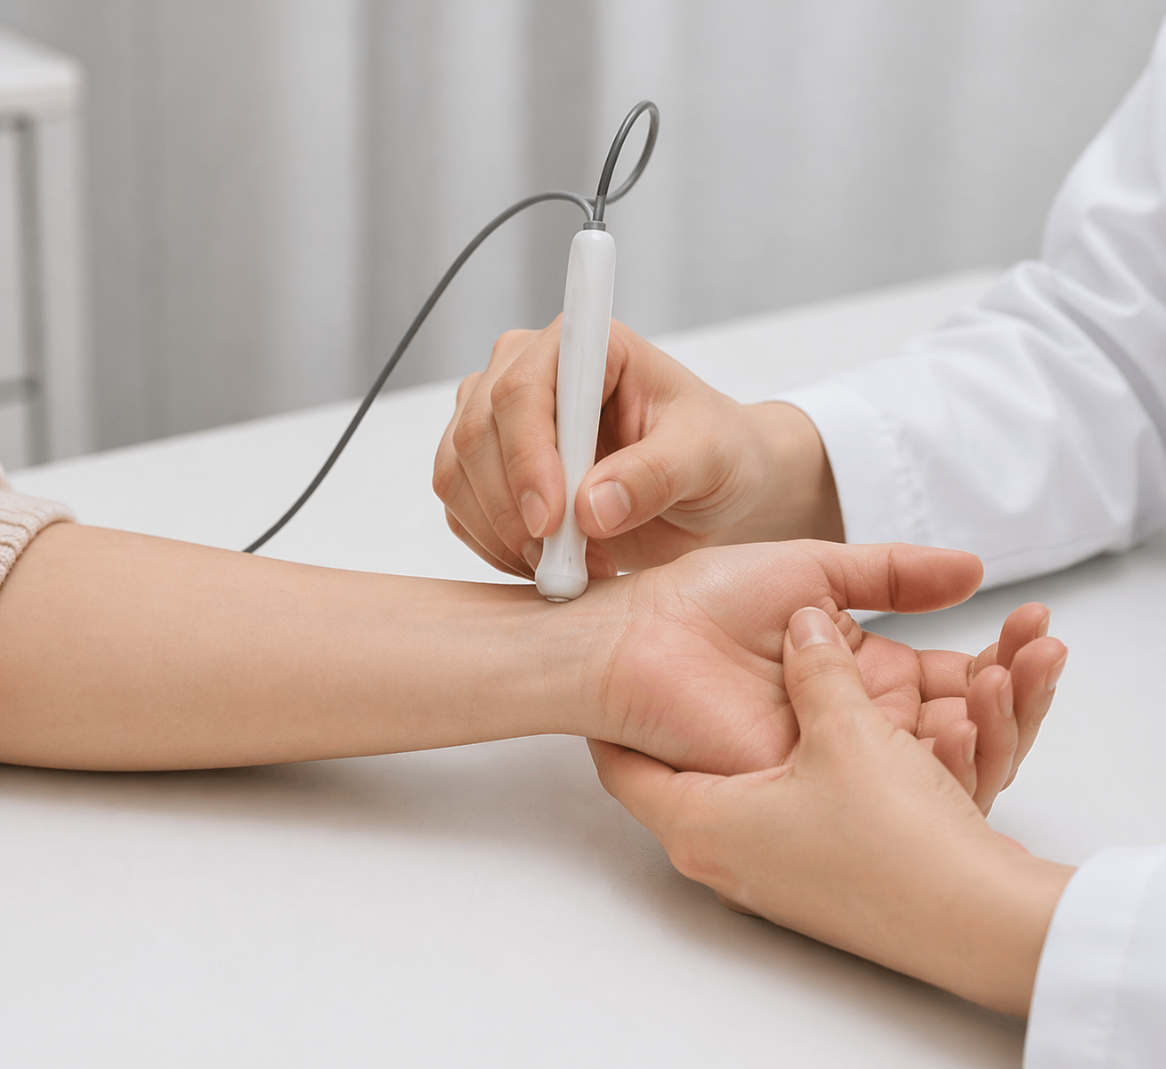
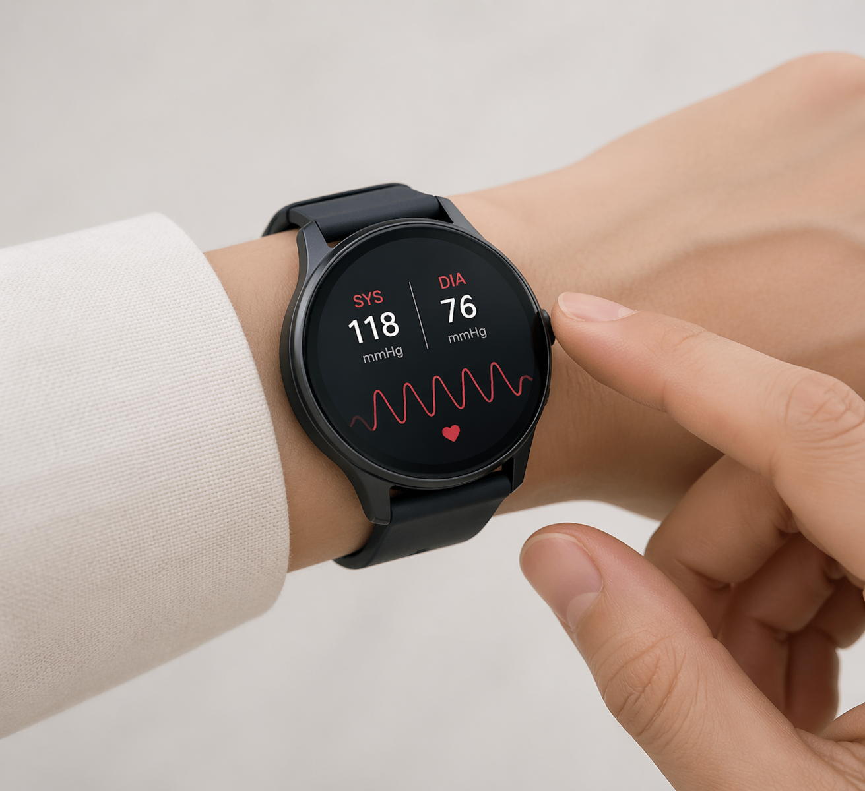
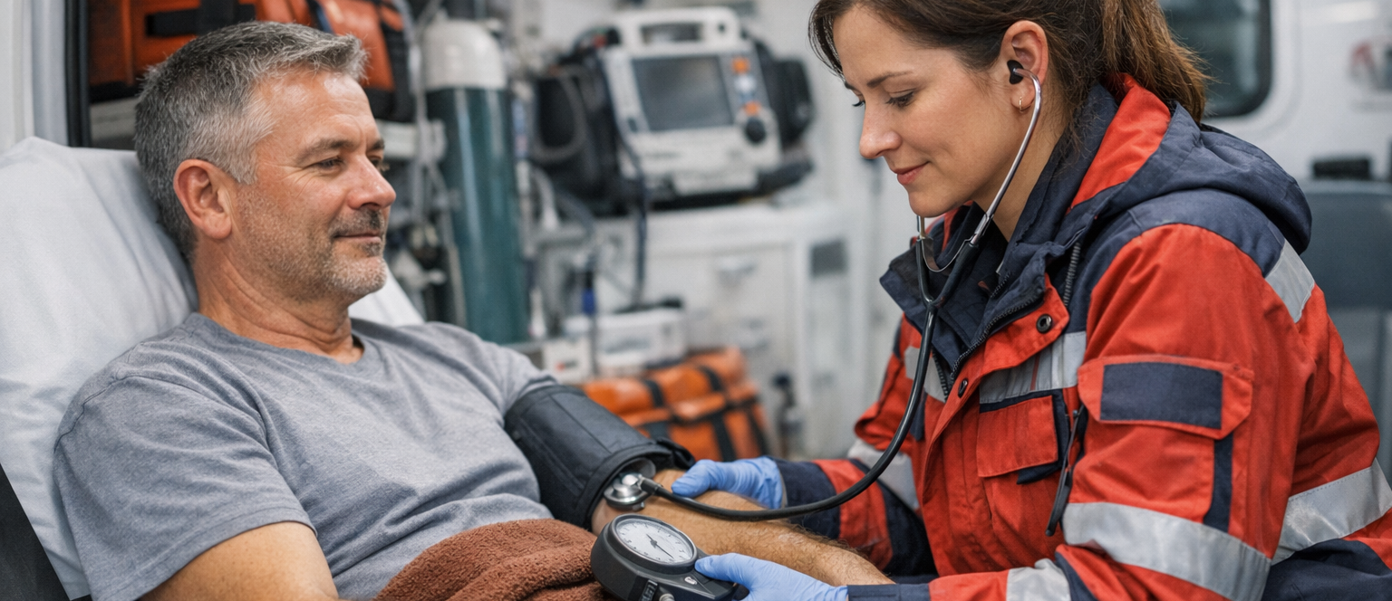

Techniques to measure blood pressure (BP)²
Arterial Line | Auscultation | Oscillometry | Volume Clamp | Tonometry | Pulse Wave | NextBP
Direct measurement | Indirect measurement: errors arise from individual differences |  | Requires calibration using external measurement to account for individuals differences |  |  | Auto-calibrates to individual
Not suitable when moving | Very difficult when moving | Unreliable when moving | Does not work when moving |  | Unreliable when moving | Movement tolerant
Continuous | Intermittent | Intermittent | Continuous
Potential Application Scenarios
Long-term monitoring
Variations in BP during the day and night predict risk of heart attacks, kidney disease, and even mental illness.¹ It is a promising target for treatment. However, existing ways of BP measurement are disruptive and unsuitable for routine use.
Our technology promises both richer information and more convenience.
FOR HEALTHCARE PROFESSIONALS
Faster to repeat measurements, motion tolerant, more reliable with unusual anatomy and physiology.
FOR PATIENTS
Measurements are more comfortable and convenient than an upper-arm cuff
Pre-hospital and emergency care
Traditional ways to measure BP fail when there is a noisy environment, a moving patient, or when physiology is changing rapidly. These factors frequently co-exist in emergency situations.
NextBP solves this information gap with BP measurements that self-calibrate to the individual patient, can be repeated frequently (within 20 seconds) and provide useful estimates during movement.
FOR HEALTH-TECH INNOVATORS
Patent protected deep-tech platform provides valuable differentiation in many segments

