Slide 1
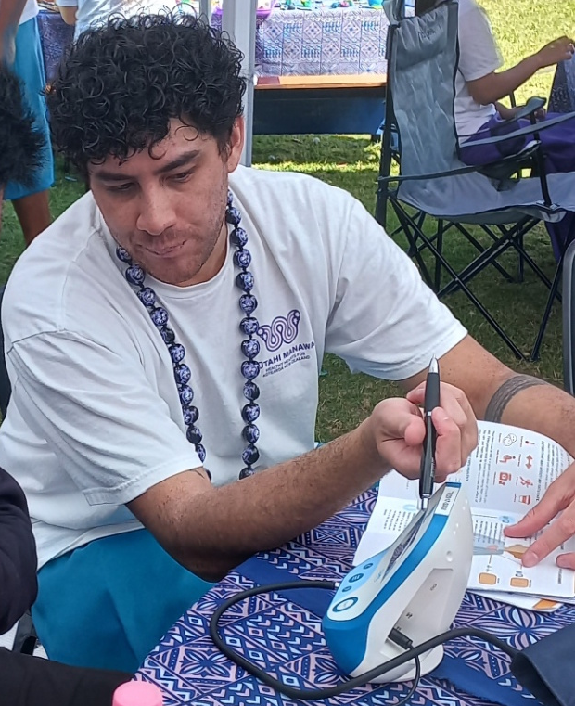




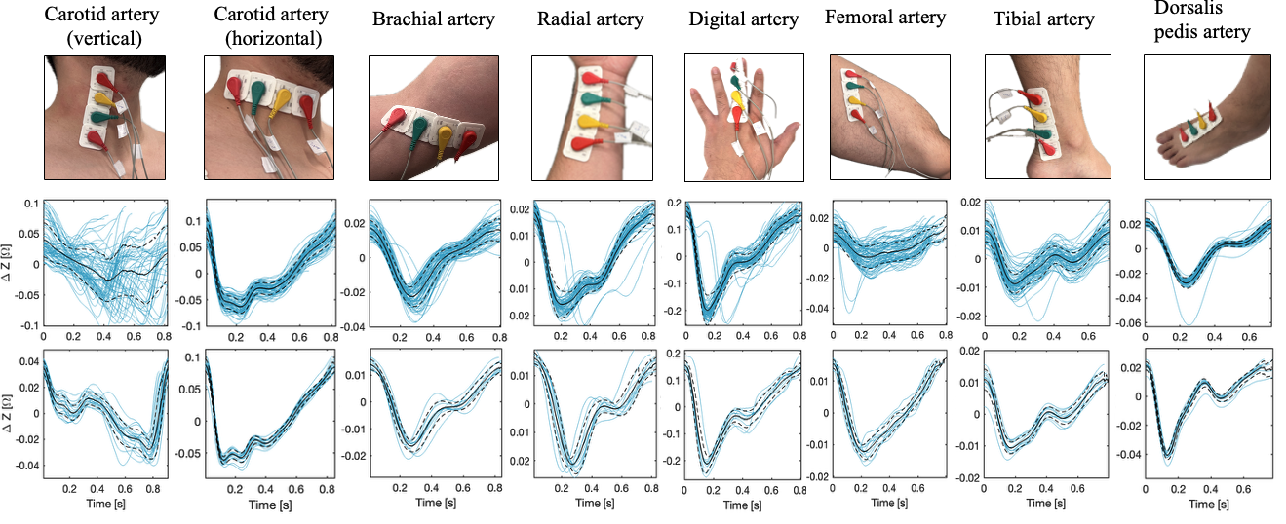
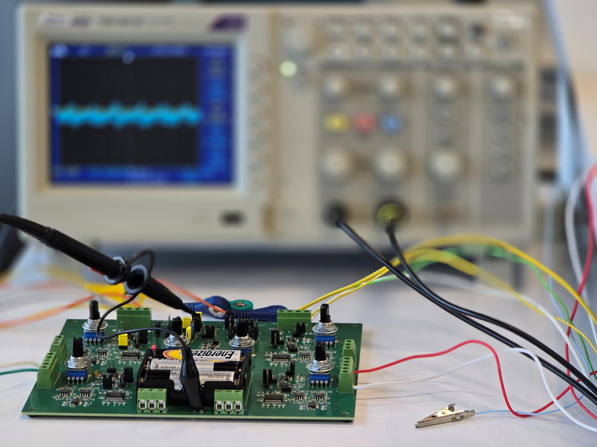

Arterial Stiffness Screening
Bringing health technology to life
Pulse wave made easy!
6
Increased arterial stiffness predicts mortality in type 2 diabetics¹
But what is normal for Māori and Pacific peoples²?
We have developed low-cost bioimpedance electronics
that can be used to easily measure accurate pulse waves from many
arteries. The sensors can be used
easily, with minimal training. This
opens the way for wide-spread measurement and screening of
elevated arterial stiffness.
20 26
Neck
Upper arm
Forearm
Finger
Technology and new capabilities
Show capability and credibility
Potential applications
Show vision
References:
Kim, J. M. et al. Arterial stiffness is an independent predictor for risk of mortality in patients with type 2 diabetes mellitus: the REBOUND study. Cardiovascular Diabetology 19, 143 (2020).
Dahiya, E., Lowe, A., Krishnamurthi, R., Anand, G. & Kalra, A. Estimating normal and reference pulse wave velocity in New Zealand population. Journal of the Royal Society of New Zealand 55, 2198–2215 (2025).
Yu, Y. Estimation of Arterial Diameter Using Bioimpedance Spectroscopy on a Human Wrist Phantom. (Auckland University of Technology, 2022).
Ankle
Foot
This research has been supported by Pūtahi Manawa: Healthy Hearts for Aotearoa New Zealand, a Centre of Research Excellence
COLLABORATION OPPORTUNITIES
We are actively seeking collaboration with healthcare providers, research institutions, and industry partners to accelerate clinical validation and real-world deployment. If
you are interested in advancing ambient cardiovascular
monitoring, we welcome the opportunity to connect.
ibtec.aut.ac.nz
Bringing health technology to life

Slide 2
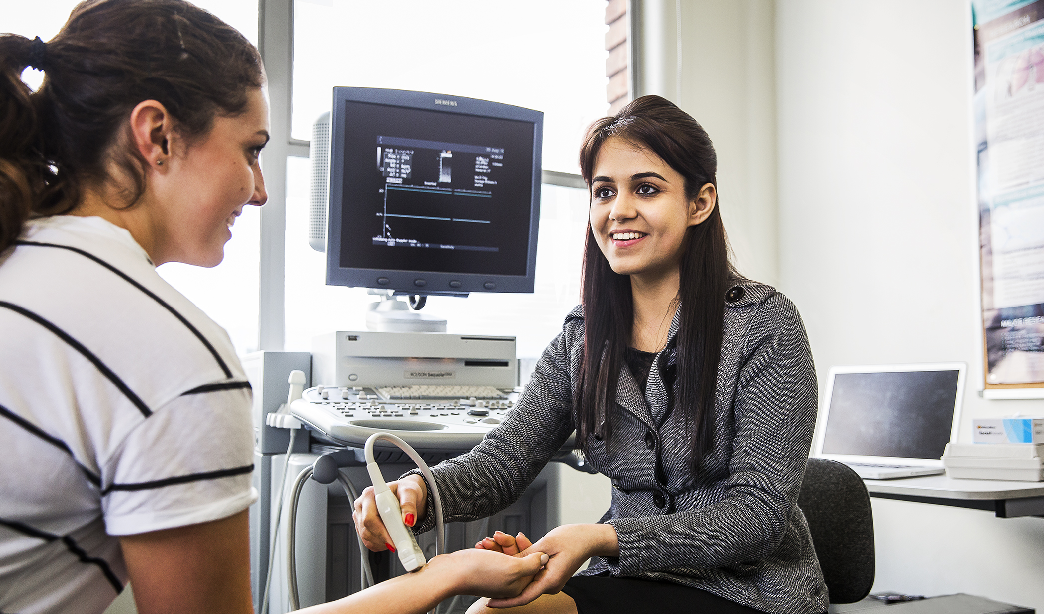
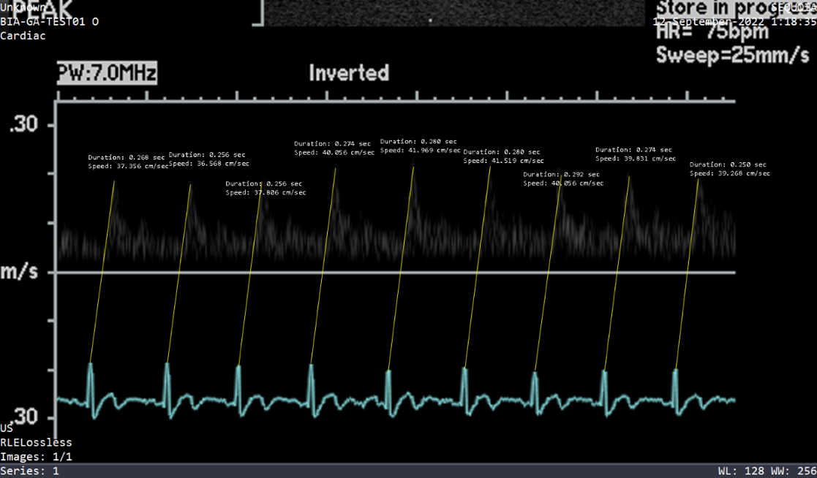
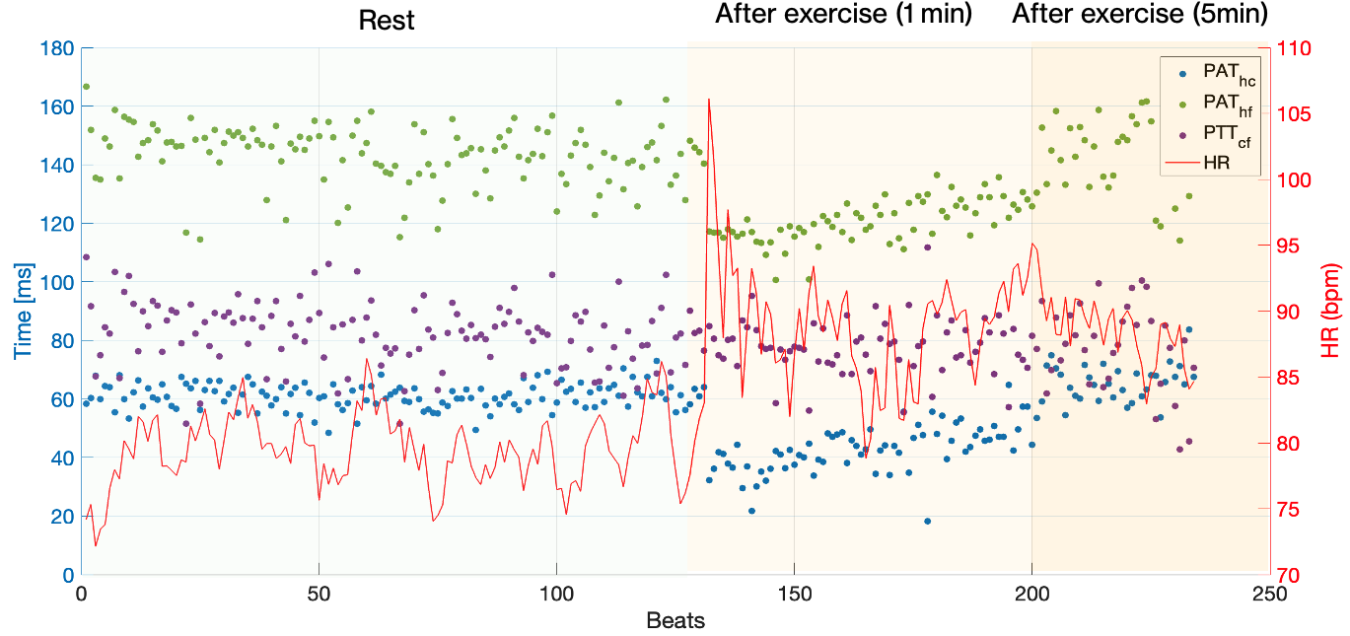
Problem and Solution
Arterial stiffness is normally measured as pulse wave velocity (PWV), which is related to the difference in timing of the pulse at two locations (such as the neck and upper leg). Current non-invasive tools for measuring PWV remain problematic, as shown in the table below:
 | Ultrasound | Tonometry | Oscillometry | Ours
More arteries measurable | ✓ | ✗ | ✗ | ✓
Minimal training required | ✗ | ✗ | ✓ | ✓
Not painful | ✓ | ✗ | ✓ | ✓
Measure trends over time | ✗ | ✗ | ✗ | ✓
Low cost | ✗ | ✗ | ✓ | ✓
Potential Application Scenarios
Wearable haemodynamic management
Our wearable pulse wave measurement technology delivers real-time insights into arterial responses to stimuli including exercise, medications and stressors. This information complements traditional factors such as heart rate, blood pressure and respiration.
What is normal?
New Zealand Māori, Pacific and many indigenous communities suffer higher rates of heart attacks, strokes and other vascular-related events.
Increased arterial stiffness has been shown to be an independent predictor of cardiovascular events, including mortality. However, Māori and Pacific are not represented in the data that defines “increased arterial stiffness”.
Our technology underpins our research to provide cost-effective, widespread measurement to correct this inequity.^{2,3}
FOR HEALTHCARE PROFESSIONALS
More insight into elevated cardiovascular risk leads to more effective conversations with patients
FOR PATIENTS AND COMMUNITIES
Measurements can be taken at much more convenient locations, at lower cost
FOR HEALTH-TECH INNOVATORS
Wearable, accurate pulse wave measurement to transform haemodynamic management

